Slide 1

Why Device Trees
Are not Static
Heinrich Schuchardt, 2020-05-16
CC-BY-SA-4.0

Slide 2

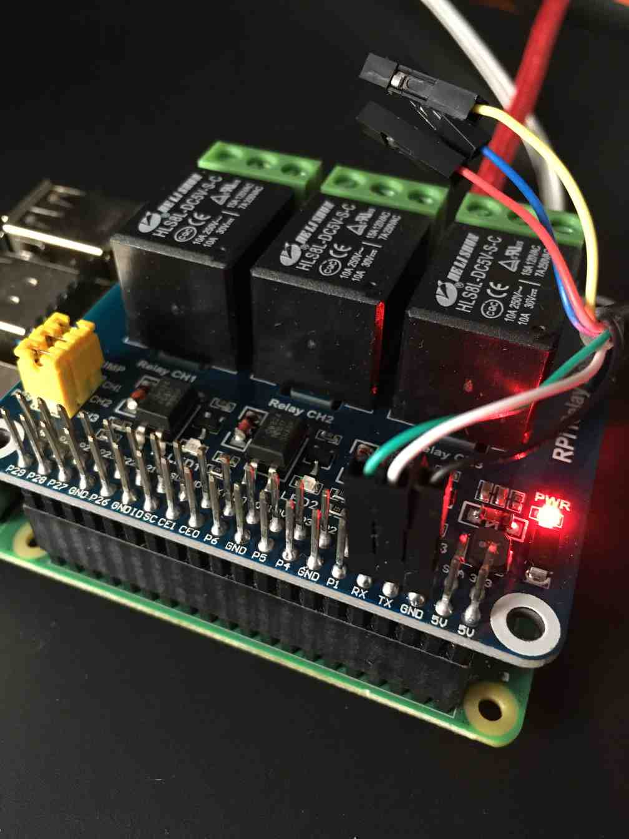
Systems Are Modular
Baseboard + SoC module
Hats (Raspberry),
Capes (BeagleBoard)
Memory modules

Slide 3
Devices Are Hot Pluggable
Even CPUs and Memory can be removed and added at runtime
Linux: Documentation/core-api/memory-hotplug.rst
Linux: Documentation/core-api/cpu_hotplug.rst

Slide 4
Is There A Master Device?
With protocols like CCIX there can be multiple bus masters.
So in future modular systems it is hard to say whose requirements dictate the “one” device tree.
Do we need separate device trees per bus master?

Slide 5
Configurable IO Routing
SoCs may have more supported IOs than connected pins.
The routing of GPIOs is configurable, e.g.
Raspberry GPIO 18 may be connected to input register, output register, PWM, SPI, PCM Audio.
PCI-e bifurcation is used to connect multiple devices to one PCI-e connector.

Slide 6
Device Configurability
Many devices contain their own firmware or even FPGA.
Device firmware changes may make the device appear completely different to the outside world.
How about
  Changing functions according to license status
  Changing CPU ISA via microcode

Slide 7
Hardware or Software?
vdd_soc: sd0 {
regulator-name = "VDD_SOC";
regulator-min-microvolt = <1000000>;
regulator-max-microvolt = <1170000>;
regulator-enable-ramp-delay = <146>;
regulator-disable-ramp-delay = <4080>;
regulator-ramp-delay = <27500>;
regulator-ramp-delay-scale = <300>;
regulator-always-on;
regulator-boot-on;
maxim,active-fps-source = <MAX77620_FPS_SRC_1>;
maxim,active-fps-power-up-slot = <1>;
maxim,active-fps-power-down-slot = <6>;
};

Slide 8
DT Nodes as Communication Area
Necessary properties, e.g.
  cpu-release-addr in CPU node for CPUs with spin-table enable-method
  Available memory
Optional properties, e.g.
  GRUB passing ‘bootargs’, ‘linux,initrd-start’, ‘linux,initrd-end’ to Linux

Slide 9
DT in the Software Stack
Some devices should only be available in secure world
  SPI flash for UEFI variables

Slide 10
Conclusion
Device trees are a mishmash of
  Hardware description
  Hardware configuration
  Software configuration
  Communication area

Slide 11
Areas for Improvement
Separation between hardware and software properties
Support for hardware modularity
Software layer specific device trees
Multiple masters (CPUs, Accelarators)
Ownership

Slide 12
Could Device Trees Be Modular?
Module
Configuration
Interface
Routing
Interface
Module
Configuration

